Slide 1

VIDEO TO AUDIO CONVERTOR
USING PYTHON

Slide 2
PRESENTER :
HANEESH-2010030323
LAHARI -2010030372
MOUNIKA -2010030384
RITHVIK -2010030421
GUIDE:
P.SREELAKSHMI

Slide 3

TABLE OF CONTENTS:
ABSTRACT
INTRODUCTION
FLOWCHART
GITHUBCOMMITS
WORK PROGRESS
ALPHA TESTING
REFERENCES

Slide 4
Converting videos to audio files is the one of the best way to listen the desirable audio without having to watch the video.
ABSTRACT:
It is most often used to record the soundtrack of videos or to extract other audio tracks from videos where you are only interested in the sound.
As, the size of the audio file is much smaller than that of a video file. If you like that video file but your device is running out of space, and thus you cannot download and store it in the device, you can easily convert it to audio format and store easily.

Slide 5
Converting video to audio files is very essential step when you are passionate music mixer or you like to create videos using differentsound effects . It will be easy Gather Sound Effects to do Remixes, special versions or covers of popular songs with desirable audio files then from video files. You can store the audio of your favourite video which may not be found from other sources. It also helps to save space, improves Sound quality, Extract Famous Movie Quotes..
INTRODUCTION:

Slide 6
FLOWCHART:
Import libraries
Input : video file
yes
If format MP4,WMV,AVI,MKV files
no
Video uploaded
Select video files only from the given format
Convert into audio
Successfully converted

Slide 7

ALGORITHM:
1. Click on upload video
2. select video file from desktop
3. uploading video file
4. showing message of the uploaded file path
5. click convert
6. converting video into audio
7. print “ Audio file generated successfully”
8. saves audio in same path

Slide 8
GITHUB COMMITS:

Slide 9
Work Progress:
DONE
TO DO
1.Develop the code so that inpute files can be taken both from computer and url.
2. Develop an online application using react and django.
1.CODE taking input as video file from computer.
2.Basic GUI application

Slide 10
FUTURE WORK:
Else if n==2
UPLOAD FILE
GIVE INPUT
1.YT URL
2.FILE
If n==1
GIVE URL
SELECT QUALITY
SAVE AUDIO
OUTPUT AUDIO
START
STOP

Slide 11
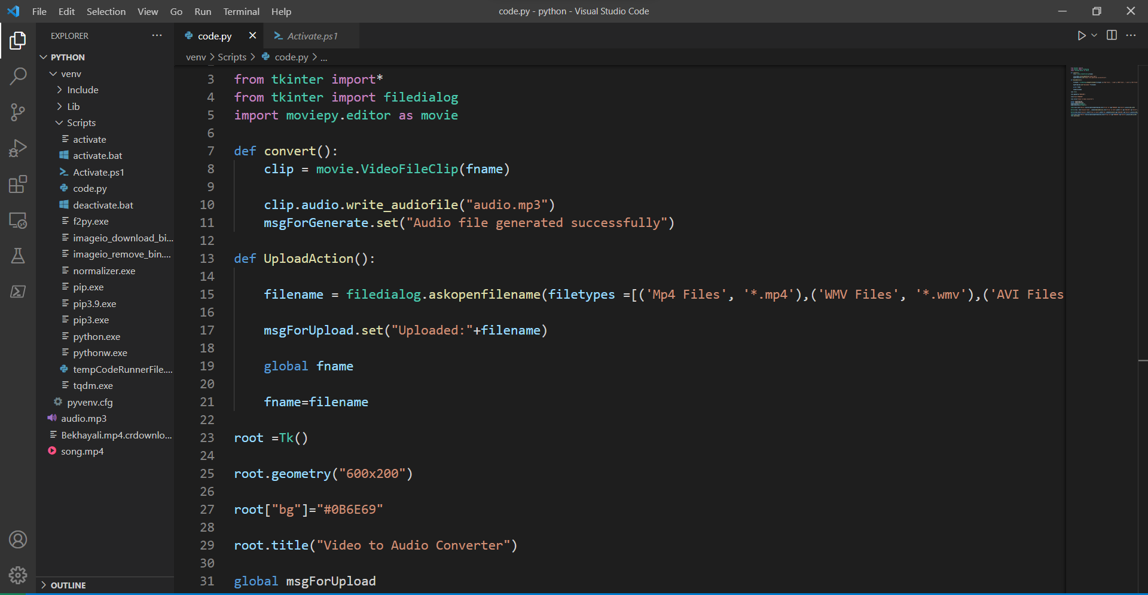
ALPHA TESTING:
1

Slide 12
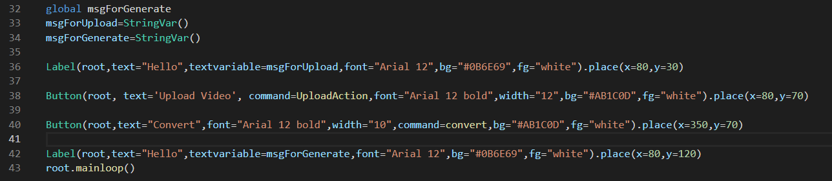
2

Slide 13
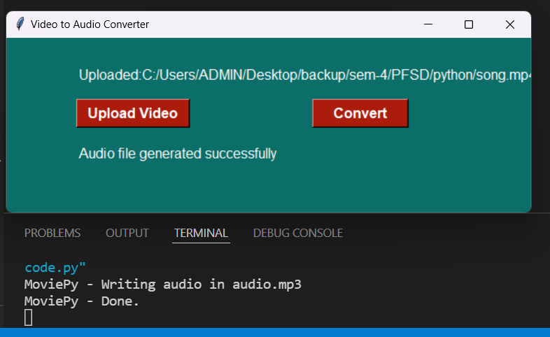
3
OUTPUT:

Slide 14
REFERENCES:
https://thecleverprogrammer.com/2020/12/08/video-to-audio-converter-with-python/
https://hvitis.dev/how-to-convert-audio-files-with-python-and-django#snippet
https://www.onlineconverter.com/audio-to-video
http://www.smbceo.com/2018/01/09/what-are-the-benefits-of-online-audio-converter/
https://ytmp3.com/

Slide 15
THANK YOU.

